Slide 1
Dialogue of Cultures
Russia – Great Britain – Germany
Motto: Culture unites us
Presentation of the Festival

Slide 2
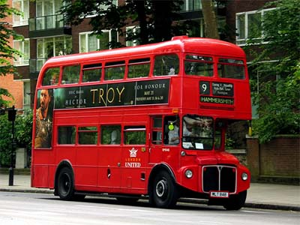
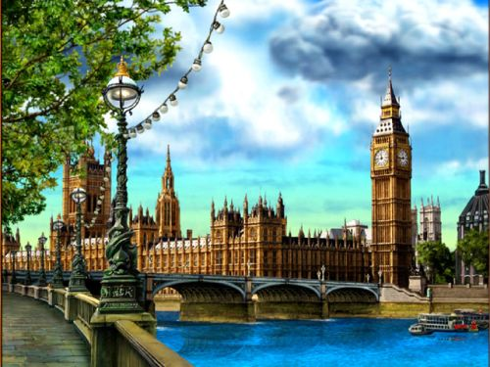
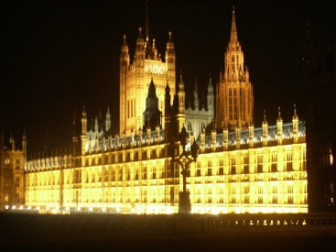
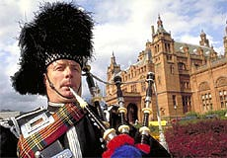
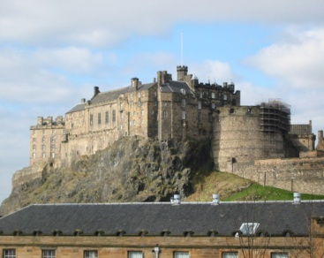
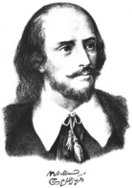
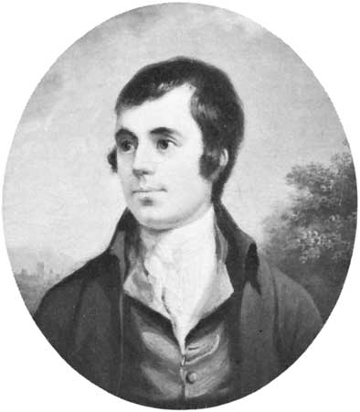
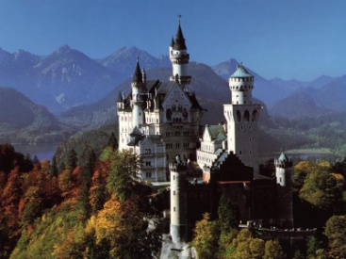
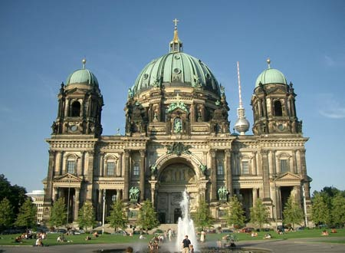
Country Study
Amazing London (reports)
Windows in Britain (video)
History of Britain (brain ring)
Country Study (quiz, crosswords)
Mysterious Scotland (reports)
Poetry by Shakespeare and Burns
Competition of translators (sonnets)
Quiz: Do you know Germany?

Slide 3
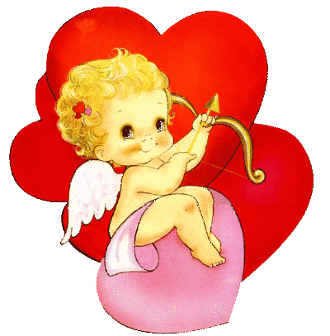
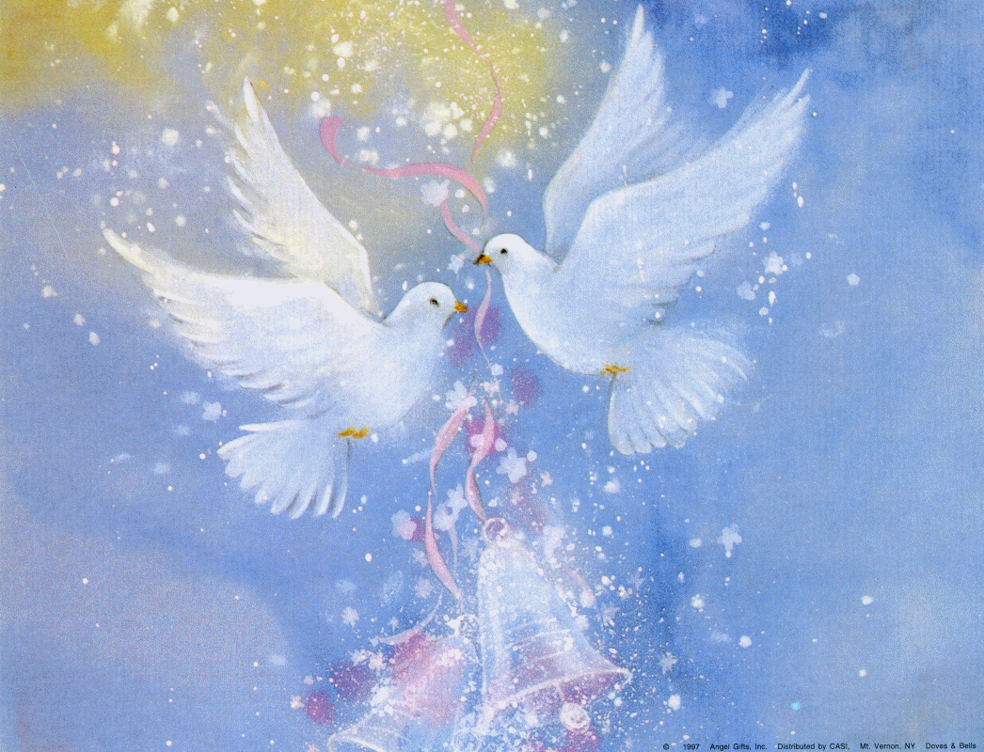
Traditions and Holidays of Great Britain
Quiz: National Holidays of the USA
St. Valentine’s Day. Traditions, symbols (compositions, games, video, integrated lessons)

Slide 4
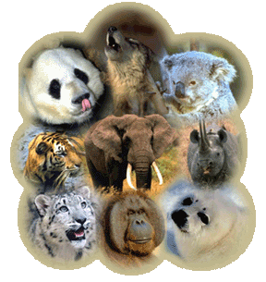
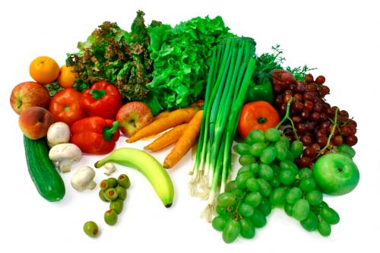
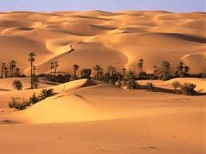
World around us
Amazing facts
Animals in danger (drawings)
Healthy life and food (newspapers)
Fact files about deserts (computer presentations)

Slide 5
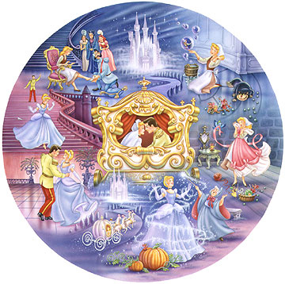
We are actors and actresses
Competitions of poems
Competitions of songs
Drama “Cinderella” – Famous Fairy Tale.

Slide 6
You are Welcome!

