Slide 1
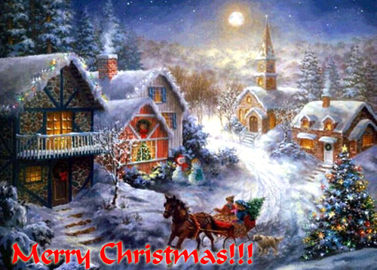

Slide 2
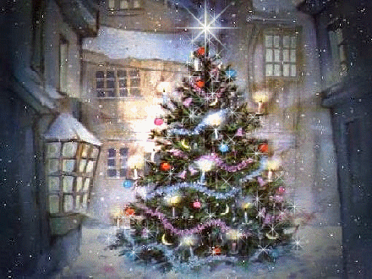
Christmas is on
the 25th of December
It is the greatest
holiday in Britain

Slide 3
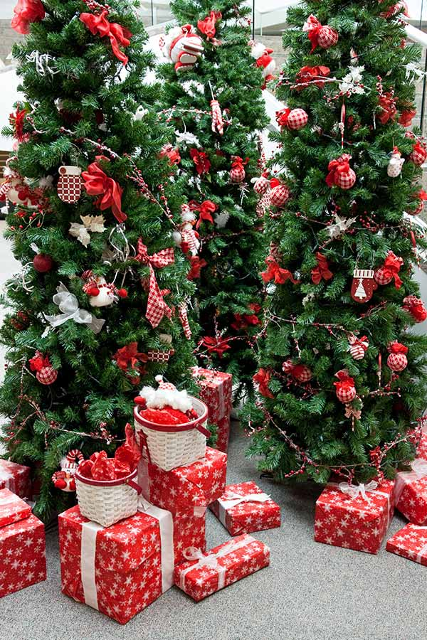
Christmas Traditions
In Britain people have many interesting Christmas traditions. Listen to the short stories about trees and presents and other Christmas traditions.

Slide 4
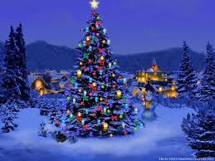
Trees and Presents
People began to celebrate Christmas many years ago. They began to decorate the evergreen tree and give presents to each other. They placed a large shining star at the top of the Christmas tree and many bright shining balls (red, blue, yellow, green, silver) from top to bottom.

Slide 5
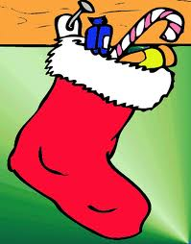
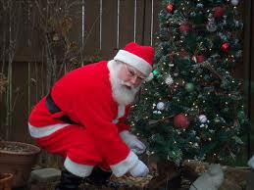
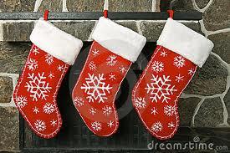
Christmas Stockings
In the evening of the 24th of December children hang their Christmas stockings on their beds or put them under the Christmas tree. Father Christmas (Santa Claus) puts presents into them. A Christmas stocking is not a real stocking. It is big and beautifully decorated.

Slide 6
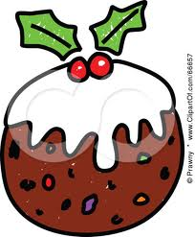
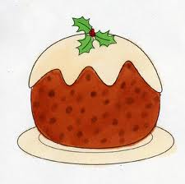
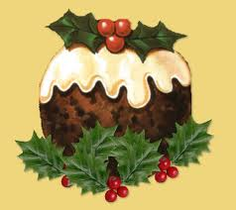
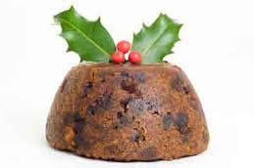
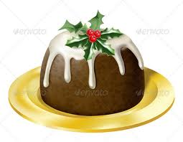
Christmas Pudding
Christmas Pudding was first made many, many years ago. Now it is the highlight of Christmas dinner. Children often put holly on the pudding. Traditionally a coin is placed into the pudding. It brings good luck to a person who finds it.

Slide 7
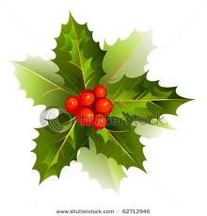
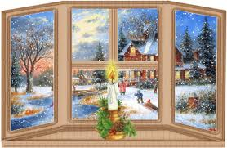
Holly
Holly is an evergreen plant with sharp-pointed leaves and red berries. You know already that people put holly on Christmas pudding. They also use holly to decorate their homes. It’s a very old tradition. Long ago people began to put holly in their homes during the dark cold winters. They liked to look at holly and think about the spring and the sun.

Slide 8
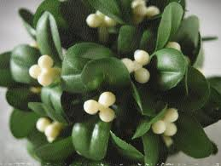
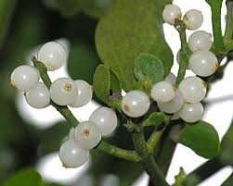
Mistletoe
Mistletoe is an evergreen plant with small leaves and small white berries. At Christmas Eve there is a bunch of mistletoe in every house. Under this bunch boys kiss girls.

Slide 9
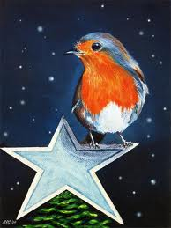
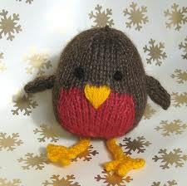
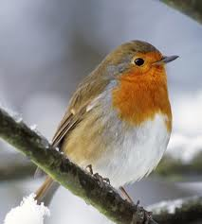
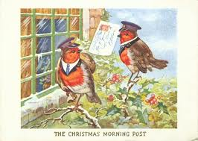
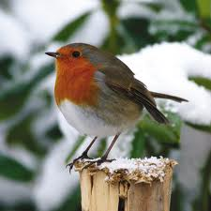
Robin
Many years ago postmen had bright red coats. They looked like robins. At Christmas they brought many Christmas cards. And people began to think about a robin as a Christmas bird. You can see it on almost every Christmas card.

Slide 10
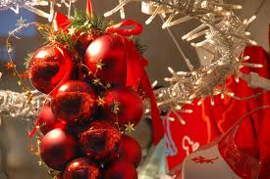
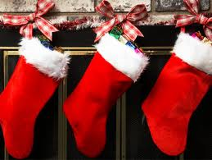
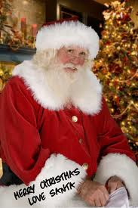
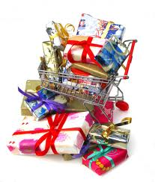
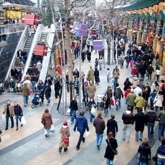
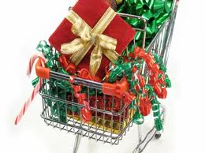
Christmas Eve
Christmas Eve is on the 24th of December. On this day everybody is very busy and in a hurry. Offices close at 1 o’clock, but the shops stay open late.
On Christmas Eve children hang their Christmas stockings on their beds. They wait for Father Christmas (Santa Claus) and other miracles.

Slide 11
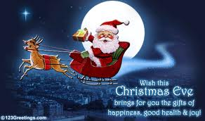
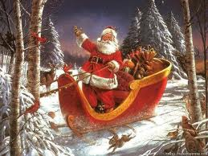
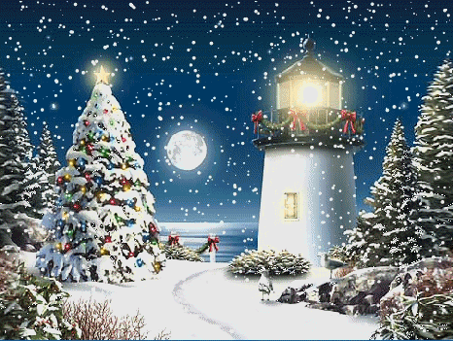
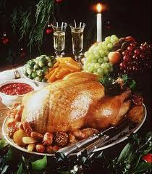
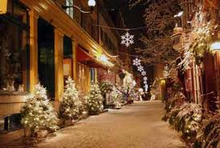
Christmas Day
Christmas Day is on the 25th of December. British people celebrate this holiday with big dinners. Children have much fun. They play under Christmas trees, find presents in their Christmas stockings, eat Christmas puddings, watch pantomimes. The grown-ups don’t go to work on that day.

Slide 12
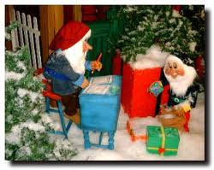
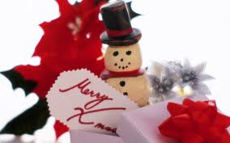
Boxing Day
Boxing Day comes after Christmas Day. It is on the 26th of December. People do not go to work on that day. They visit friends or go to the theatre. Everybody gives and receives Christmas cards and Christmas boxes.

Slide 13
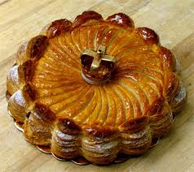
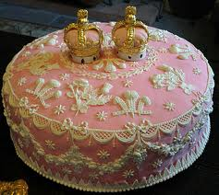
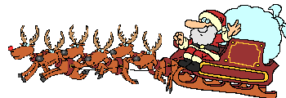
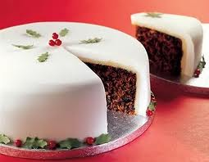
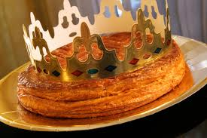
Twelfth Night
The Twelfth night is on the eve of the 6th of January. This is the twelfth day after Christmas Day. It is the last day of Yuletide. People eat the Twelfth cake on the Twelfth night. This is a big cake with a coin baked inside. The person who finds a coin in his piece of cake becomes the king of the Twelfth night.

Slide 14
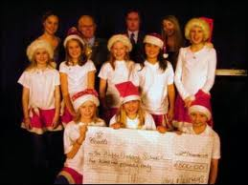
European Christmas Song Contest
The European Christmas Song Contest is held during Yuletide. Singers from Britain, France, Finland, Italy and other European countries sing Christmas songs.

Slide 15
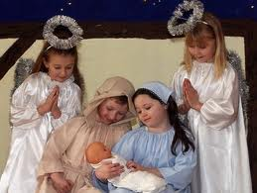
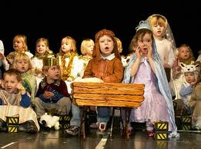
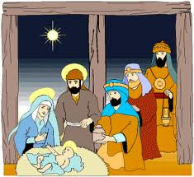
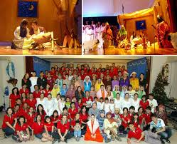
Nativity Play
The Nativity Play tells the tale of Christ’s Birth. Children usually perform this play themselves. They perform it at school before Christmas.

Slide 16
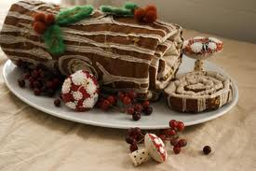
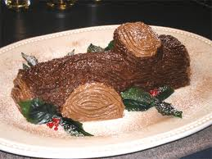
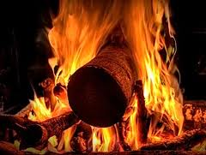
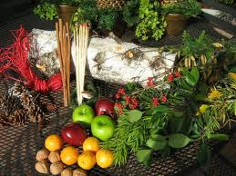
Yule Log
A Yule log is a piece of wood which people burn in the fireplace on Christmas Eve

Slide 17
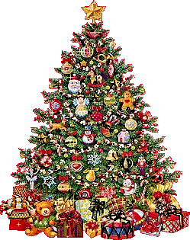
Merry Christmas!

